Slide 1
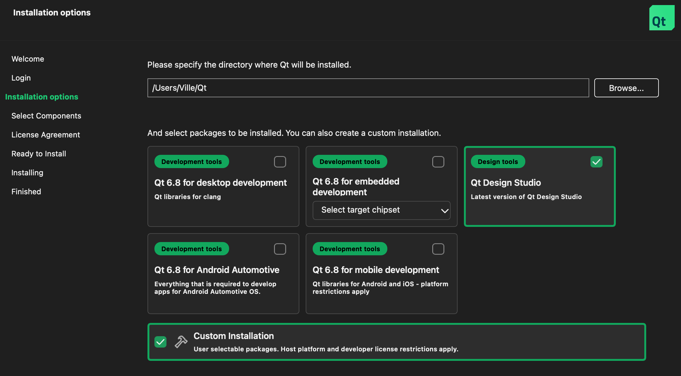
Installer
Current layout (4.9)

Slide 2
Choosing what to install, alternative 1
Displaying hierarchically
Choose partner evaluation installation
Section shown only if the
user has any partner evaluation
licenses available
Renesas
Everything that is needed to evaluate the Qt functionality and tools on Renesas XYZ board.
Avnet
Everything that is needed to evaluate the Qt functionality and tools on Avnet ABC board.
Section title shown only if the
user has any partner evaluation
licenses available
Choose regular installation
Qt 6.8 for desktop development
Qt libraries for clang
Qt 6.8 for embedded development
AWS EC2 ARM64
Development tools
Development tools

Slide 3
Choosing what to install, alternative 2
Displaying tagged (partner installation alternatives first)
VENDOR1
Everything that is needed to evaluate the Qt functionality and tools on VENDOR1 XYZ board.
VENDOR2
Everything that is needed to evaluate the Qt tools on VENDOR2 ABC board (no QBSP, only tools).
Qt 6.8 for desktop development
Qt libraries for clang
Partner evaluation
Partner evaluation
Development tools
Select target chipset
Qt 6.8 for embedded development
Qt Design Studio
Latest version of Qt Design Studio
Development tools
Design tools
Select target chipset

