Slide 1
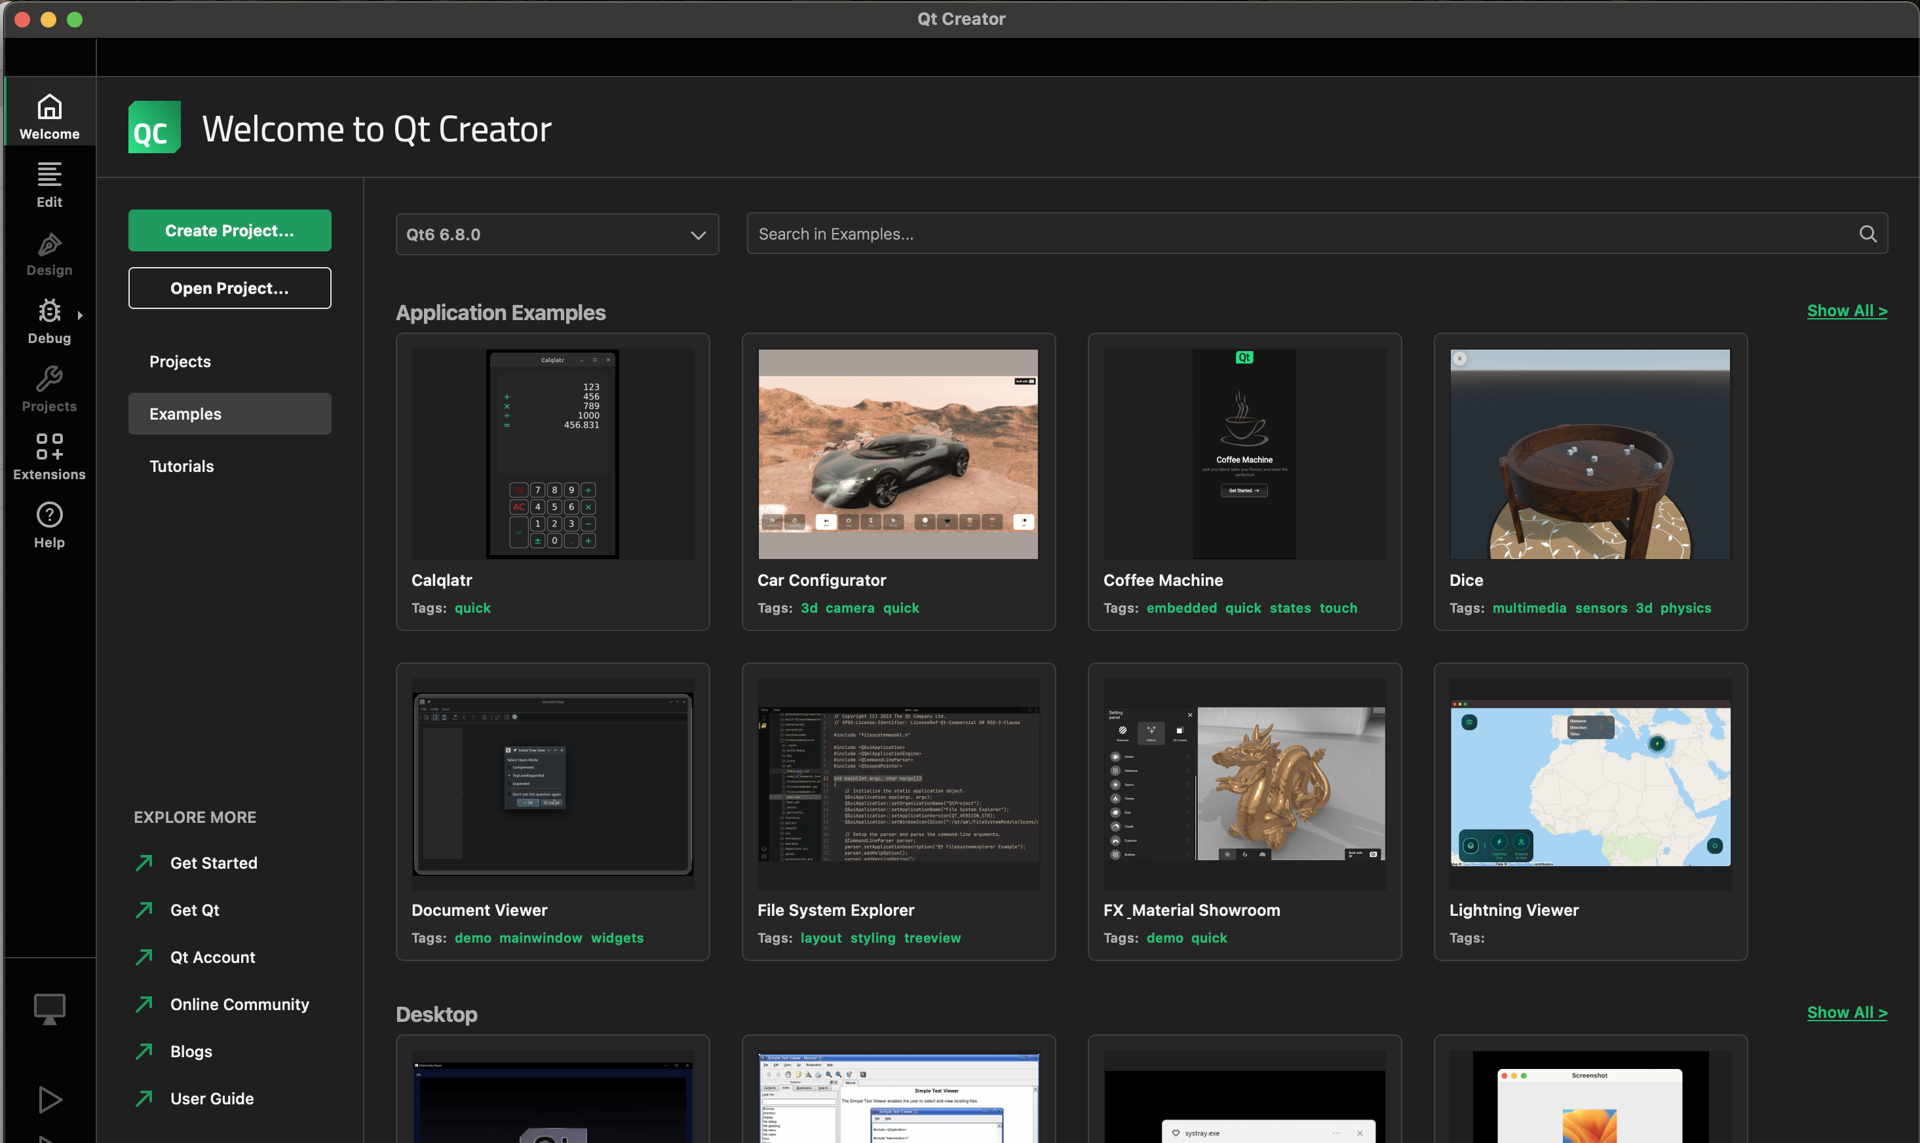
Alternative 1: During onboarding
Mockup
Qt Creator setup
Use Qt Creator Extensions?
Qt Creator Extensions are available from configured online sources (such as Qt Creator Extension Store provided by Qt Group).
By linking or connecting external repositories, you acknowledge these conditions and accept responsibility for managing associated risks appropriately.
You can manage the use of Extensions in Settings > Extensions.
Enable use of Qt Creator Extensions
Back
Next
Step 3 of 5: extensions

Slide 2
Changes & interactions
Add a new phase to the guided onboarding flow (to be introduced in Qt Creator 18, Figma design)
Remove externalRepoSwitch from Extension Mode
When the user completes the flow, store the value of the checkbox to settings.useExternalRepo
  true → set settings.useExternalRepo to false
  false → set settings.useExternalRepo to false
settings.useExternalRepo defaults to false
User is allowed to abandon the onboarding at any stage by closing the guided flow.
  Add a new attribute to track whether onboarding was completed by the user
    settings.onboardingCompleted defaults to false
    settings.onboardingCompleted set to true when the user clicks on “done” on the last page of the flow

Slide 3
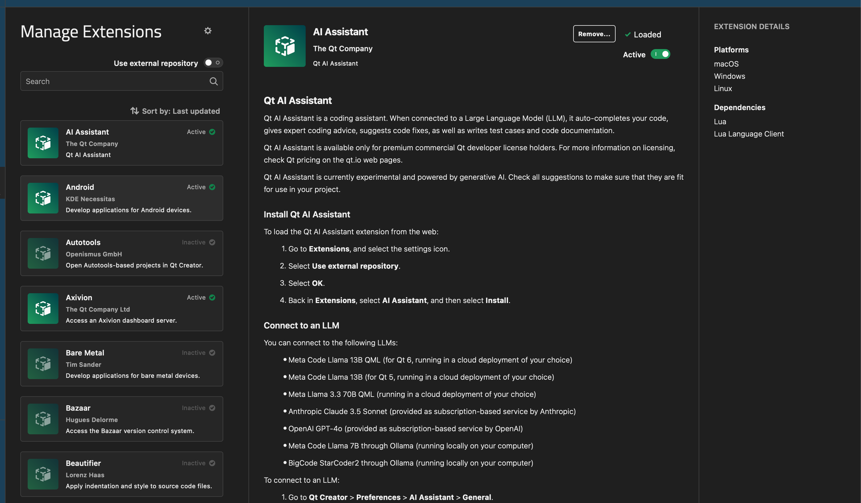
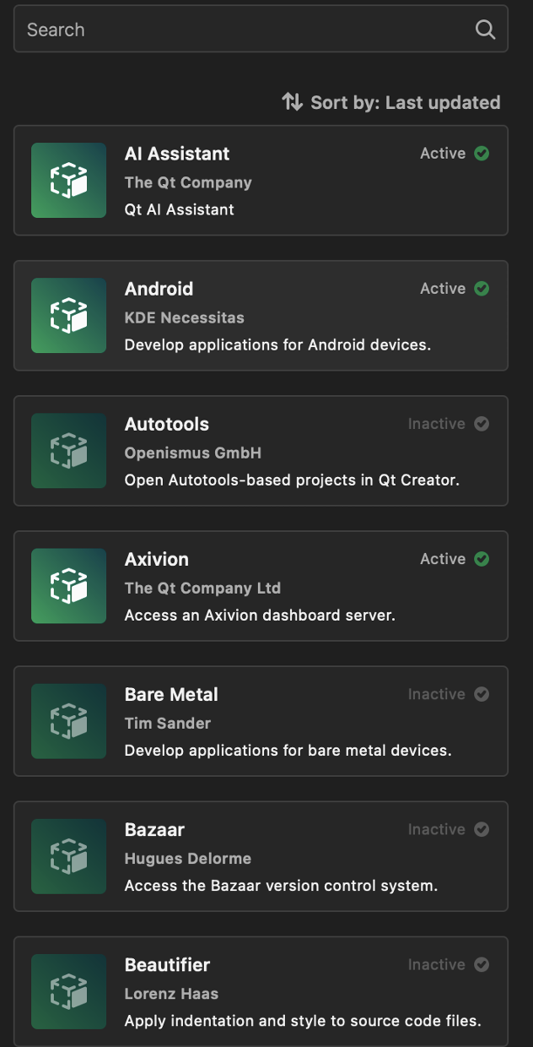
Alternative 2: Qt Creator Extension Mode
Mockup
Use Qt Creator Extensions?
This extension mode displays the Qt Creator Extensions available from configured online sources (such as Qt Creator Extension Store provided by Qt Group).
If you choose to link or connect an external repository, you are acting at your own discretion and risk.
By linking or connecting external repositories, you acknowledge these conditions and accept responsibility for managing associated risks appropriately.
You can manage the use of Extensions in Settings > Extensions.
Use
Do not use
Never show this again

Slide 4
Changes & interactions
Remove externalRepoSwitch from Extension Mode
When the user first selects Extension Mode and the user has not previously completed the onboarding flow, display the dialogue shown on the previous page
  Dialogue -
    Shown only when
      settings.onboardingCompleted is false and
      settings.skipExtensionsDialogue is false
    Modal/overlay to ensure that user must react to the question
      Component selection TBC
  Buttons
    “Use” → set settings.useExternalRepo to true
    “Don’t use” → set settings.useExternalRepo to false
  Switch
    “Never show this again” → set settings.skipExtensionsDialogue to true
settings.useExternalRepo defaults to false
settings.skipExtensionsDialogue defaults to false

